Slide 1

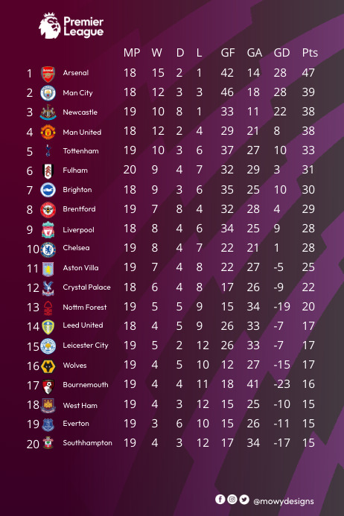
PRIMEIR LEAGUE POINTS TABLE

Slide 2

ABSTRACT
This project involves creating a relational database system for managing football match data. The database includes tables for teams, matches, match results, standings, and points accumulation. Each table is interconnected, allowing for efficient storage, retrieval, and analysis of football match information. The database facilitates tracking team performances, match results, and points earned throughout the season, providing valuable insights for teams, coaches, and analysts.

Slide 3
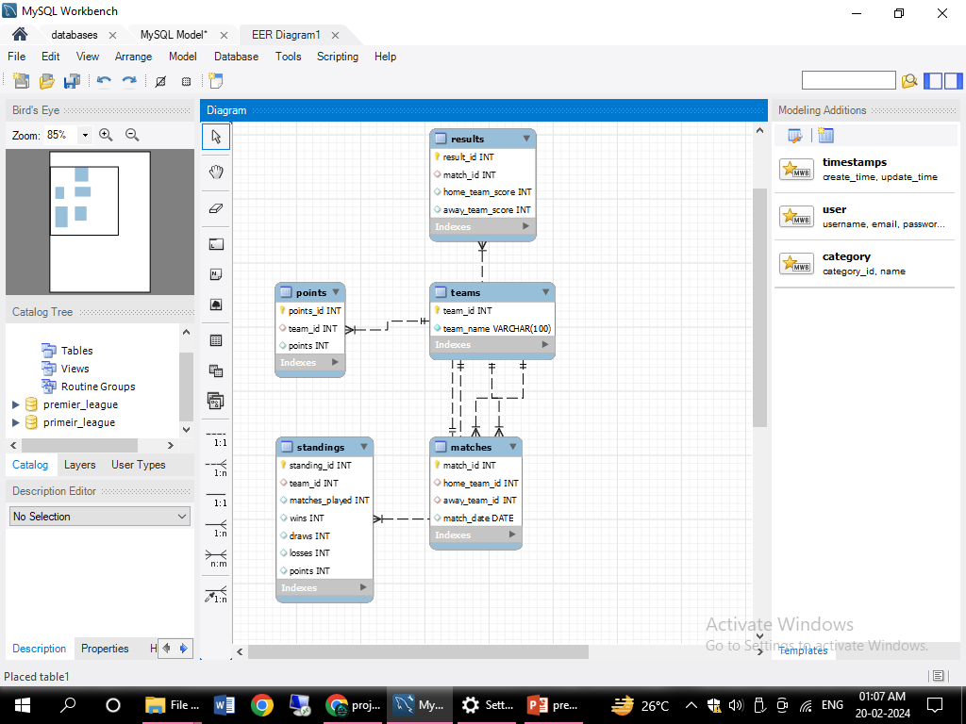
ER- DIAGRAM

Slide 4
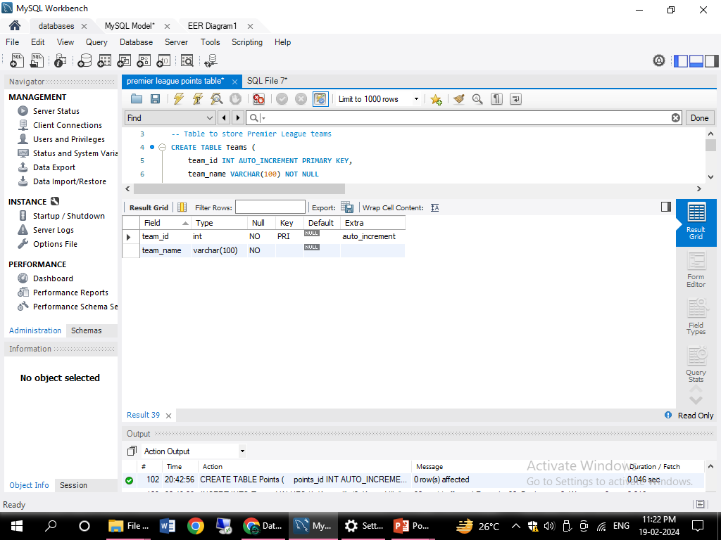
STRUCTURE OF TABLE
TEAMS TABLE
THIS TABLE SHOWS THE TEAMS ID AND TEAM NAMES .
SYNTAX: DESC TEAMS;

Slide 5
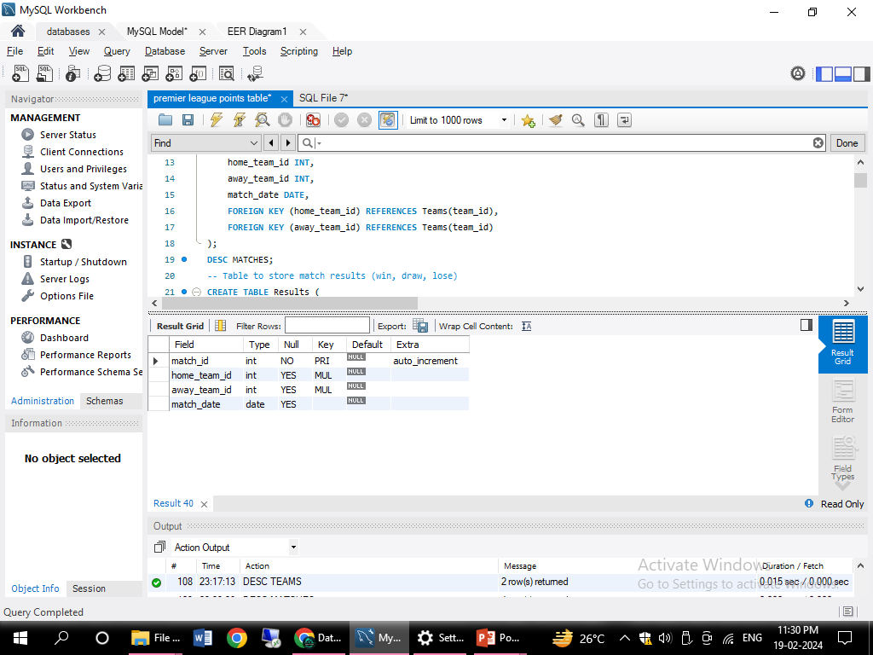
STRUCTURE OF TABLE
TABLE MATCHES
THIS TABLE HAVE
(match_id INT AUTO_INCREMENT PRIMARY KEY, home_team_id INT, away_team_id INT, match_date DATE, FOREIGN KEY (home_team_id) REFERENCES Teams(team_id), FOREIGN KEY (away_team_id) REFERENCES Teams(team_id))
SYNTAX : DESC MATCHES;

Slide 6
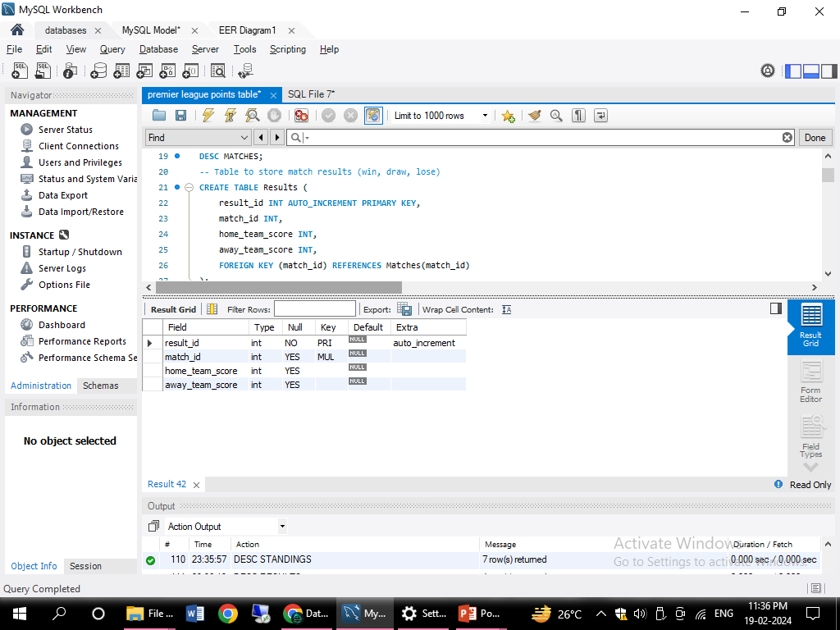
STRUCTURE OF TABLE
RESULTS TABLE
(result_id INT AUTO_INCREMENT PRIMARY KEY, match_id INT, home_team_score INT, away_team_score INT, FOREIGN KEY (match_id) REFERENCES Matches(match_id));
SYNTAX : DESC RESULTS

Slide 7
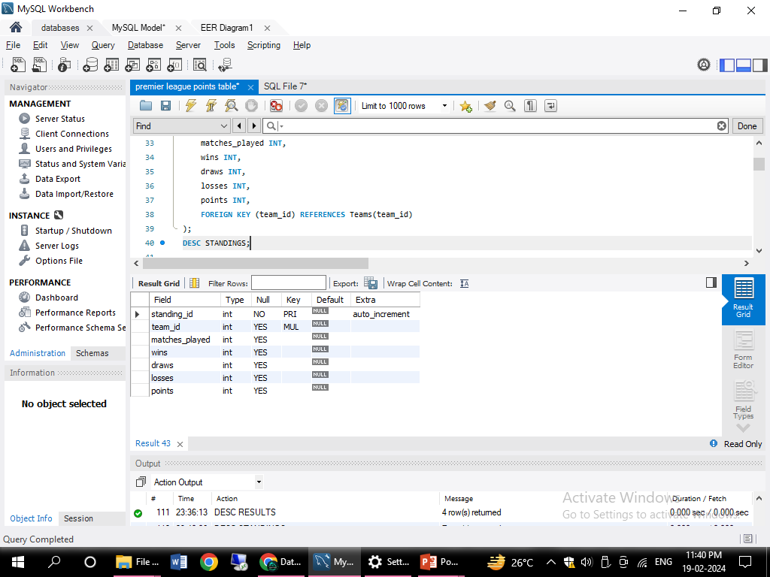
STRUCTURE OF TABLE
TABLE STANDINGS
TABLE STANDINGS HAVE
( standing_id INT AUTO_INCREMENT PRIMARY KEY, team_id INT, matches_played INT, wins INT, draws INT, losses INT, points INT, FOREIGN KEY (team_id) REFERENCES Teams(team_id));
SYNTAX : DESC STANDINGS

Slide 8
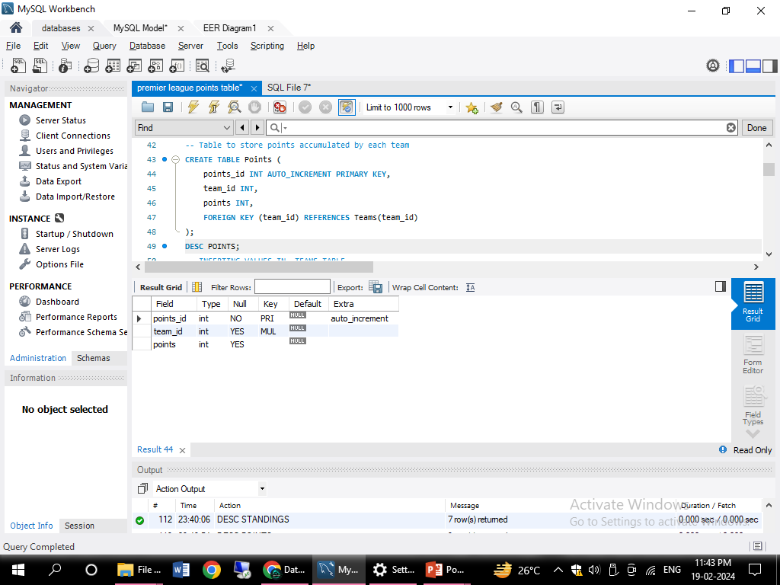
STRUCTURE OF TABLE
TABLE POINTS
( points_id INT AUTO_INCREMENT PRIMARY KEY, team_id INT, points INT, FOREIGN KEY (team_id) REFERENCES Teams(team_id));
SYNTAX- DESC POINTS;

Slide 9
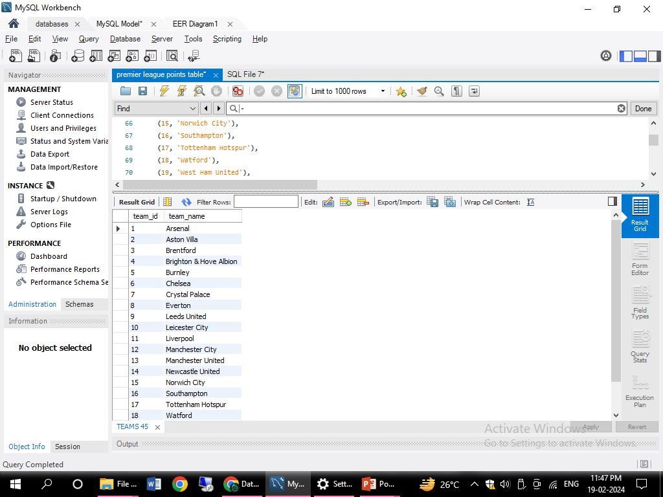
TEAMS TABLE INSERT VALUES

Slide 10
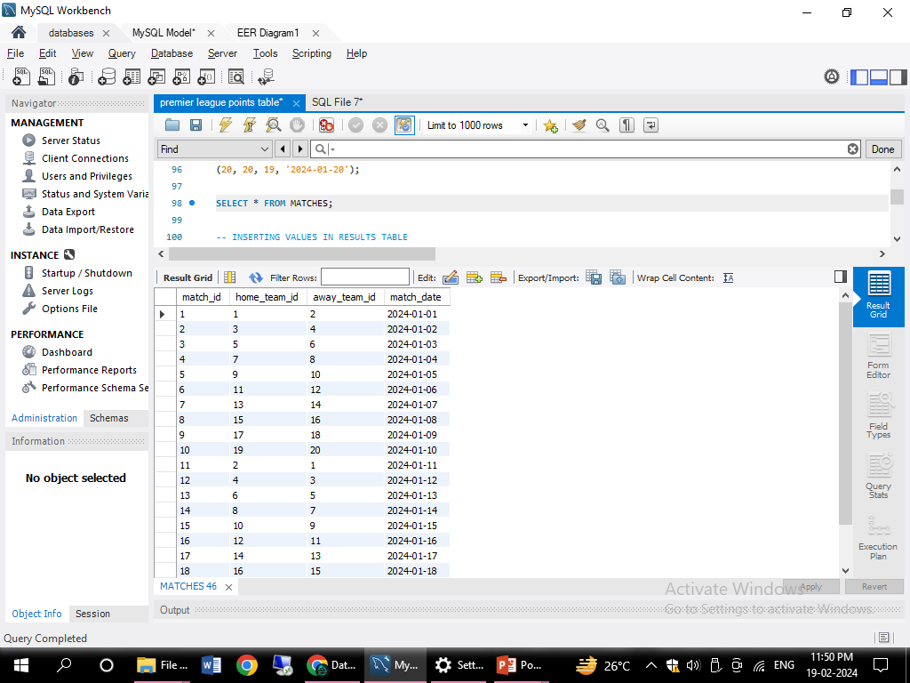
MATCHES TABLE INSERT VALUES

Slide 11
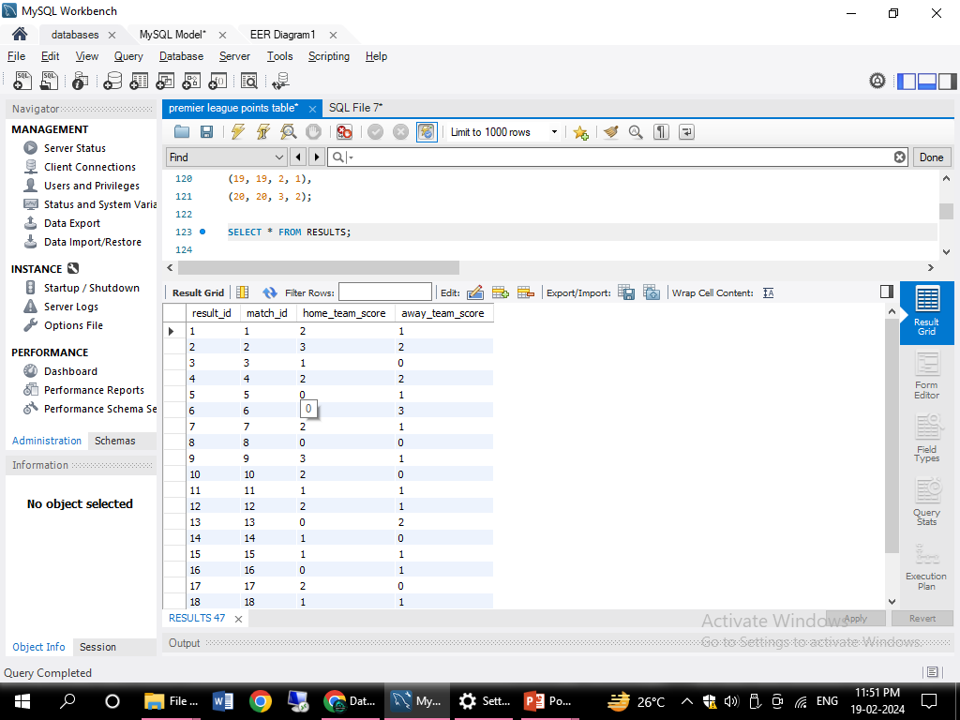
RESULTS TABLE INSERT VALUES

Slide 12
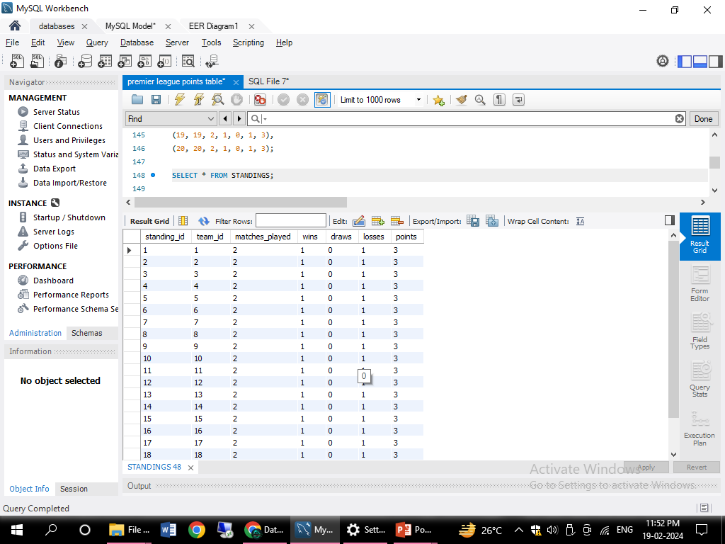
STANDINGS TABLE INSERT VALUES

Slide 13
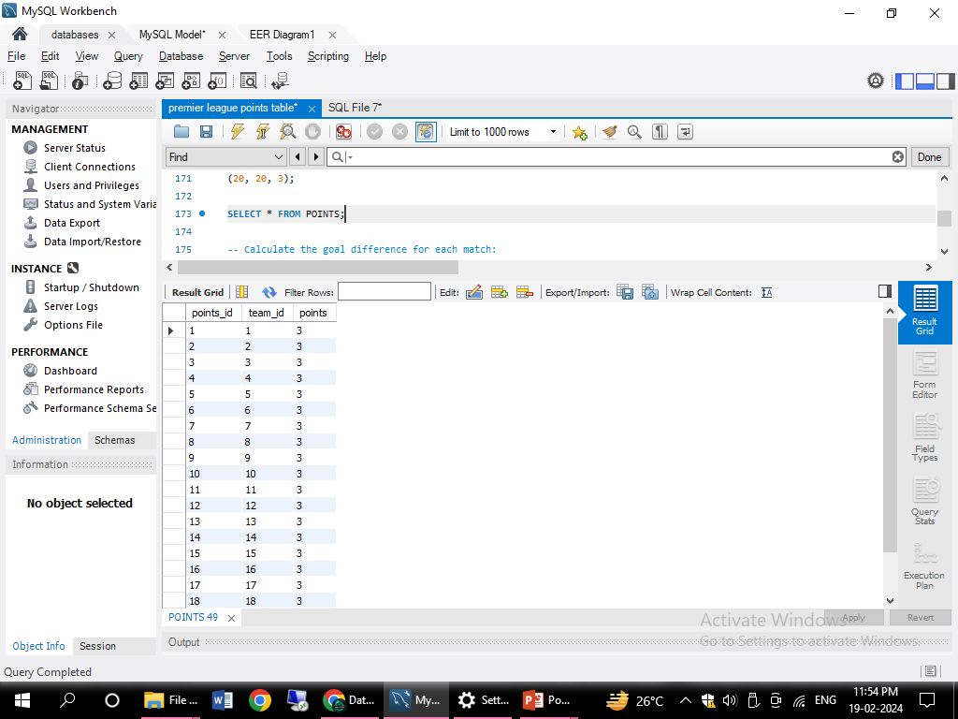
POINTS TABLE INSERT VALUES

Slide 14

SUB QUERIES

Slide 15
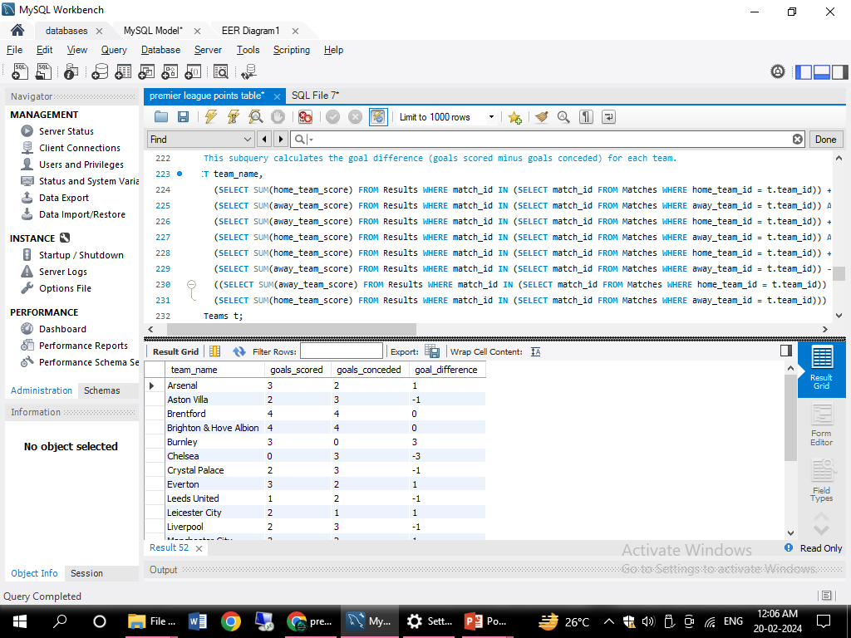
SUBQUERY -This subquery calculates the goal difference (goals scored minus goals conceded) for each team.
DFS

Slide 16
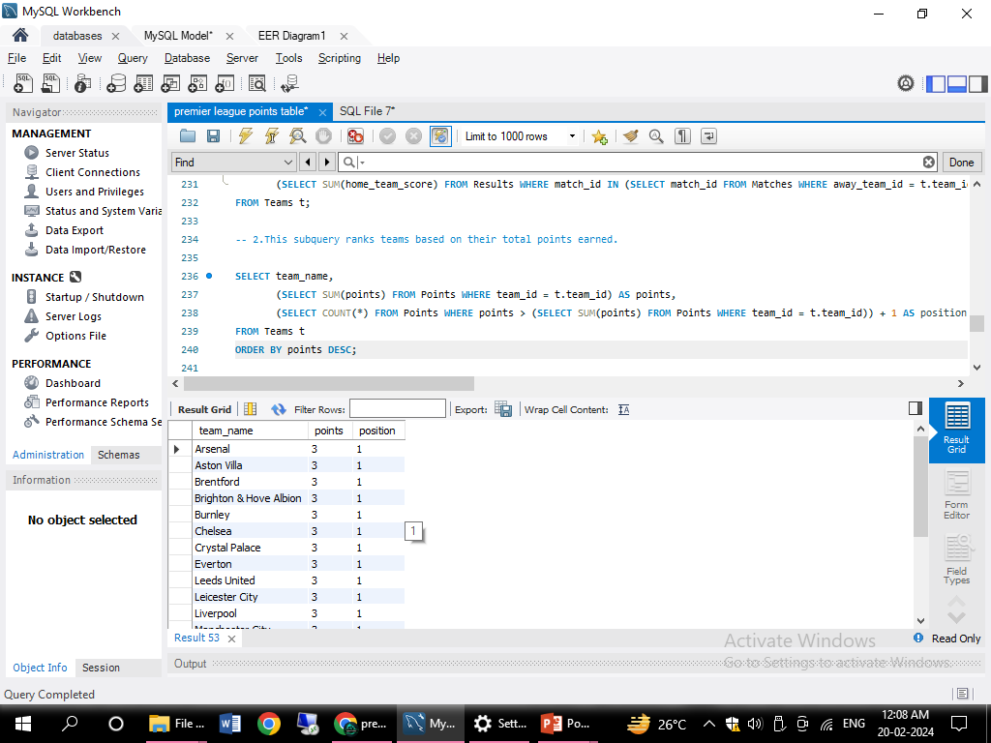
SUBQUERY
This subquery ranks teams based on their total points earned
SYNTAX-
SELECT team_name, (SELECT SUM(points) FROM Points WHERE team_id = t.team_id) AS points, (SELECT COUNT(*) FROM Points WHERE points > (SELECT SUM(points) FROM Points WHERE team_id = t.team_id)) + 1 AS positionFROM Teams tORDER BY points DESC;

Slide 17
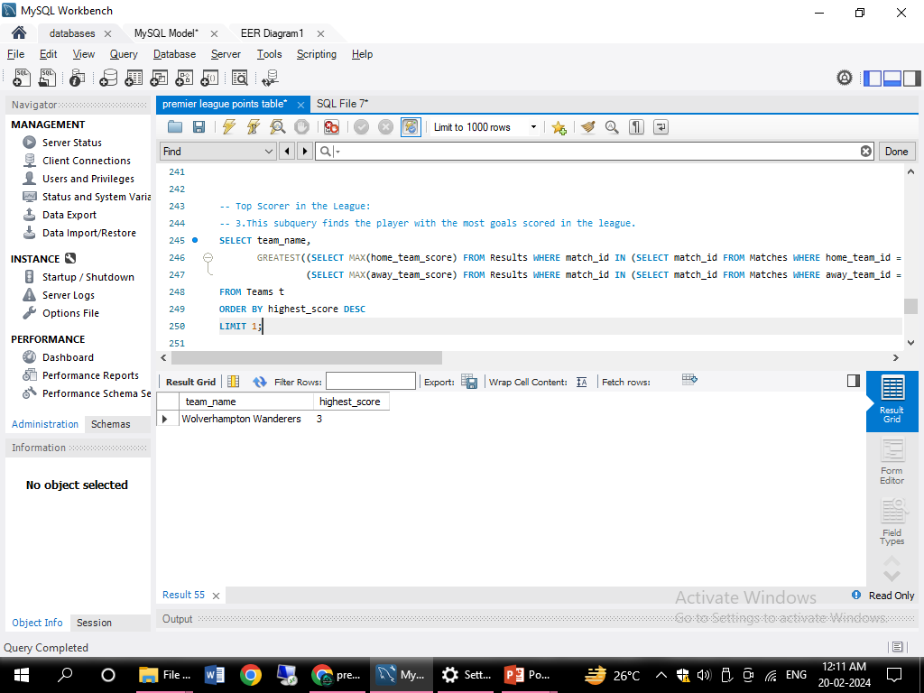
SUBQUERY
This subquery finds the player with the most goals scored in the league
SELECT team_name, GREATEST((SELECT MAX(home_team_score) FROM Results WHERE match_id IN (SELECT match_id FROM Matches WHERE home_team_id = t.team_id)), (SELECT MAX(away_team_score) FROM Results WHERE match_id IN (SELECT match_id FROM Matches WHERE away_team_id = t.team_id))) AS highest_scoreFROM Teams tORDER BY highest_score DESCLIMIT 1;

Slide 18
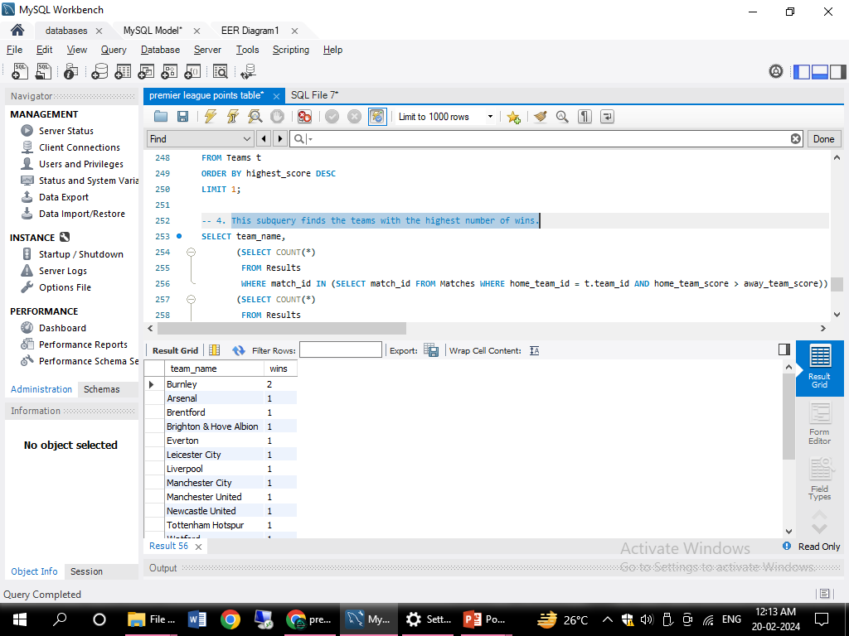
SUBQUERY
This subquery finds the teams with the highest number of wins.
SELECT team_name, (SELECT COUNT(*) FROM Results WHERE match_id IN (SELECT match_id FROM Matches WHERE home_team_id = t.team_id AND home_team_score > away_team_score)) + (SELECT COUNT(*) FROM Results WHERE match_id IN (SELECT match_id FROM Matches WHERE away_team_id = t.team_id AND away_team_score > home_team_score)) AS winsFROM Teams tORDER BY wins DESC;

Slide 19

JOINS

Slide 20
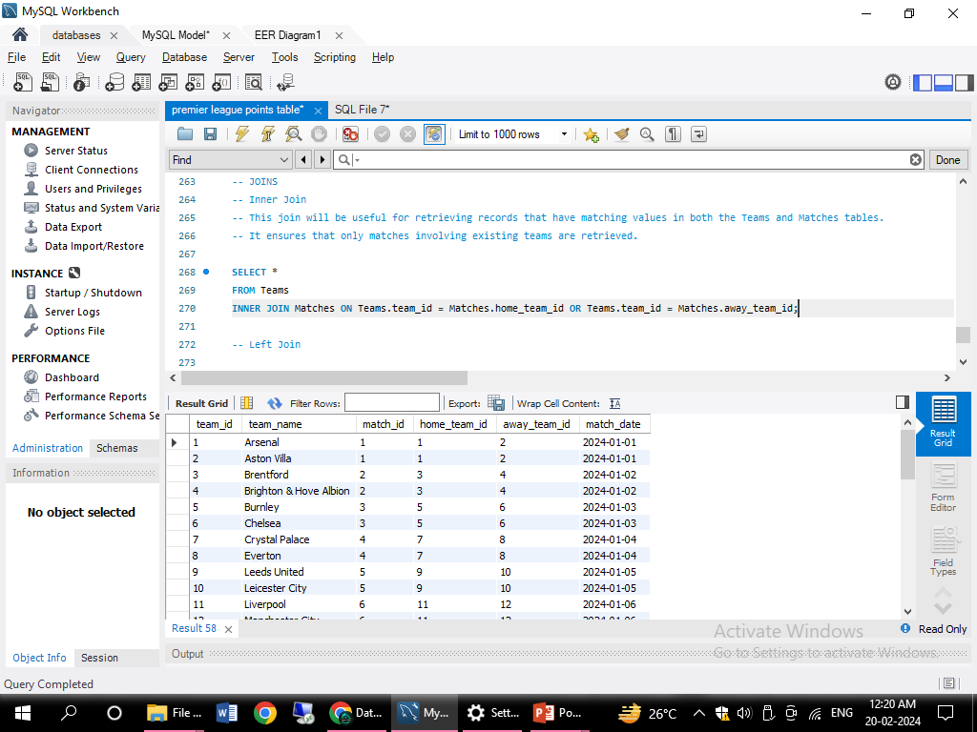
JOINS.
SQL query combines data from the Teams table and the Matches table based on whether each team participated as either the home team or the away team in any given match.
SELECT *FROM TeamsINNER JOIN Matches ON Teams.team_id = Matches.home_team_id OR Teams.team_id = Matches.away_team_id;

Slide 21
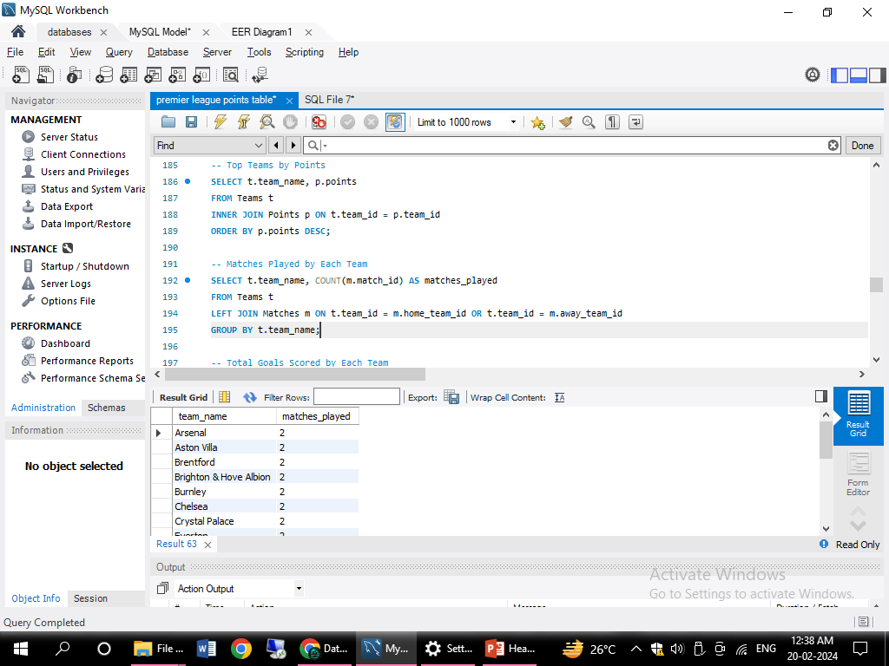
JOINS.
Matches Played by Each Team
SELECT t.team_name, COUNT(m.match_id) AS matches_playedFROM Teams tLEFT JOIN Matches m ON t.team_id = m.home_team_id OR t.team_id = m.away_team_idGROUP BY t.team_name;

Slide 22
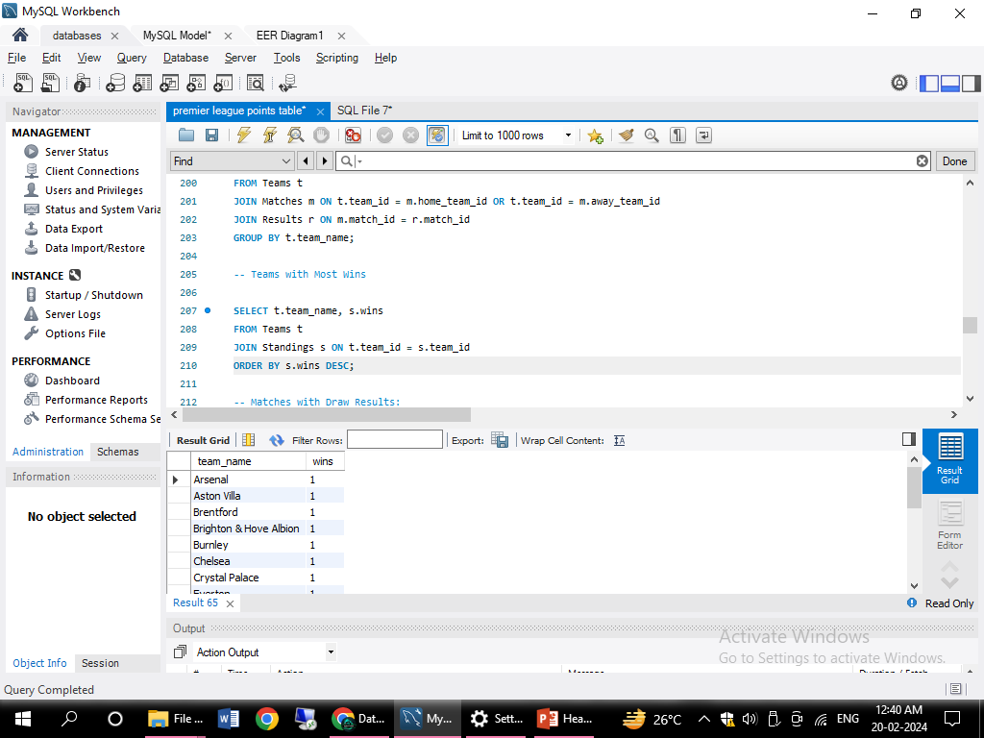
JOINS.
Teams with Most Wins
SELECT t.team_name, s.winsFROM Teams tJOIN Standings s ON t.team_id = s.team_idORDER BY s.wins DESC;

Slide 23
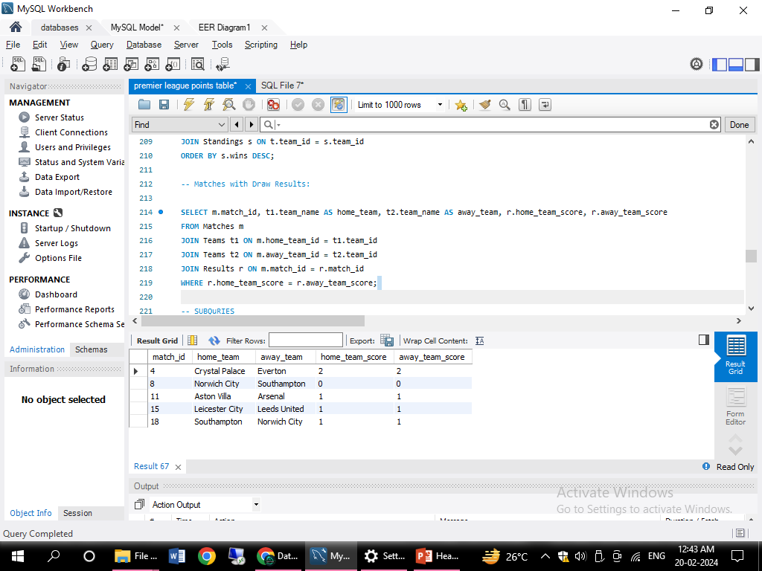
JOINS
Matches with Draw Results:
SELECT m.match_id, t1.team_name AS home_team, t2.team_name AS away_team, r.home_team_score, r.away_team_scoreFROM Matches mJOIN Teams t1 ON m.home_team_id = t1.team_idJOIN Teams t2 ON m.away_team_id = t2.team_idJOIN Results r ON m.match_id = r.match_idWHERE r.home_team_score = r.away_team_score;

Slide 24

PREPARED BY :
MANTHAN BHARGUDE
IT VEDANT
BATCH NOV-23-T313/DS/PS 11AM-1PM

Slide 25



THANK YOU

